Slide 1
A
B
Mn3p
No | Name | Position (eV) | FWHM (eV) | Line shape | At%
1 | Mn⁴⁺-Peak 1 | 49.58 | 1.55 | GL(20) | 17.50
2 | Mn⁴⁺-Peak 2 | 50.93 | 1.55 | GL(20) | 4.52
3 | Mn⁴⁺-Peak 3 | 52.32 | 1.55 | GL(20) | 1.66
4 | Mn⁴⁺-Peak 4 | 53.72 | 1.55 | GL(20) | 0.91
5 | Mn⁴⁺-Peak 5 | 55.2 | 1.55 | GL(20) | 0.18
6 | Mn³⁺-Peak 1 | 48.38 | 1.4 | GL(20) | 40.99
7 | Mn³⁺-Peak 2 | 49.56 | 1.4 | GL(20) | 17.46
8 | Mn³⁺-Peak 3 | 50.75 | 1.4 | GL(20) | 9.55
9 | Mn³⁺-Peak 4 | 52.16 | 1.4 | GL(20) | 3.98
10 | Mn³⁺-Peak 5 | 56.21 | 1.2 | GL(20) | 0.04
11 | Mn²⁺-Peak 1 | 47.18 | 1.4 | GL(20) | 2.22
12 | Mn²⁺-Peak 2 | 47.8 | 1.59 | GL(20) | 0.71
13 | Mn²⁺-Peak 3 | 49.23 | 3.41 | GL(20) | 0.28
70.02 % Mn³⁺
24.77% Mn⁴⁺
3.21% Mn²⁺
XPS spectra of Mn3p in α-MnO₂ catalyst. The fitting parameters of the Mn3p spectra, such as the relative amounts of each oxidation state, were presented in (B). The spectra were fitted by considering Mn²⁺, Mn³⁺ and Mn4⁺ for Mn3p following the protocol created by Ilton, E.S. et al. (Ilton, E. S. et al., Appl. Surf. Sci. 2016, 366, 475.). The spectra were obtained using a pass energy of 23.5 eV and calibrated using the Au4f_{7/5} peak at 84.0 eV.

Slide 2
(A)
(B)
Mn3p
No | Name | Position (eV) | FWHM (eV) | Line shape | At%
1 | Mn⁴⁺-Peak 1 | 49.58 | 1.55 | GL(20) | 17.50
2 | Mn⁴⁺-Peak 2 | 50.93 | 1.55 | GL(20) | 4.52
3 | Mn⁴⁺-Peak 3 | 52.32 | 1.55 | GL(20) | 1.66
4 | Mn⁴⁺-Peak 4 | 53.72 | 1.55 | GL(20) | 0.91
5 | Mn⁴⁺-Peak 5 | 55.2 | 1.55 | GL(20) | 0.18
6 | Mn³⁺-Peak 1 | 48.38 | 1.4 | GL(20) | 40.99
7 | Mn³⁺-Peak 2 | 49.56 | 1.4 | GL(20) | 17.46
8 | Mn³⁺-Peak 3 | 50.75 | 1.4 | GL(20) | 9.55
9 | Mn³⁺-Peak 4 | 52.16 | 1.4 | GL(20) | 3.98
10 | Mn³⁺-Peak 5 | 56.21 | 1.2 | GL(20) | 0.04
11 | Mn²⁺-Peak 1 | 47.18 | 1.4 | GL(20) | 2.22
12 | Mn²⁺-Peak 2 | 47.8 | 1.59 | GL(20) | 0.71
13 | Mn²⁺-Peak 3 | 49.23 | 3.41 | GL(20) | 0.28
70.02 % Mn³⁺
24.77% Mn⁴⁺
3.21% Mn²⁺
XPS spectra of Mn3p in α-MnO₂ catalyst. The fitting parameters of the Mn3p spectra, such as the relative amounts of each oxidation state, were presented in (B). The spectra were fitted by considering Mn²⁺, Mn³⁺ and Mn4⁺ for Mn3p following the protocol created by Ilton, E.S. et al. (Ilton, E. S. et al., Appl. Surf. Sci. 2016, 366, 475.). The spectra were obtained using a pass energy of 23.5 eV and calibrated using the Au4f_{7/5} peak at 84.0 eV.

Slide 3
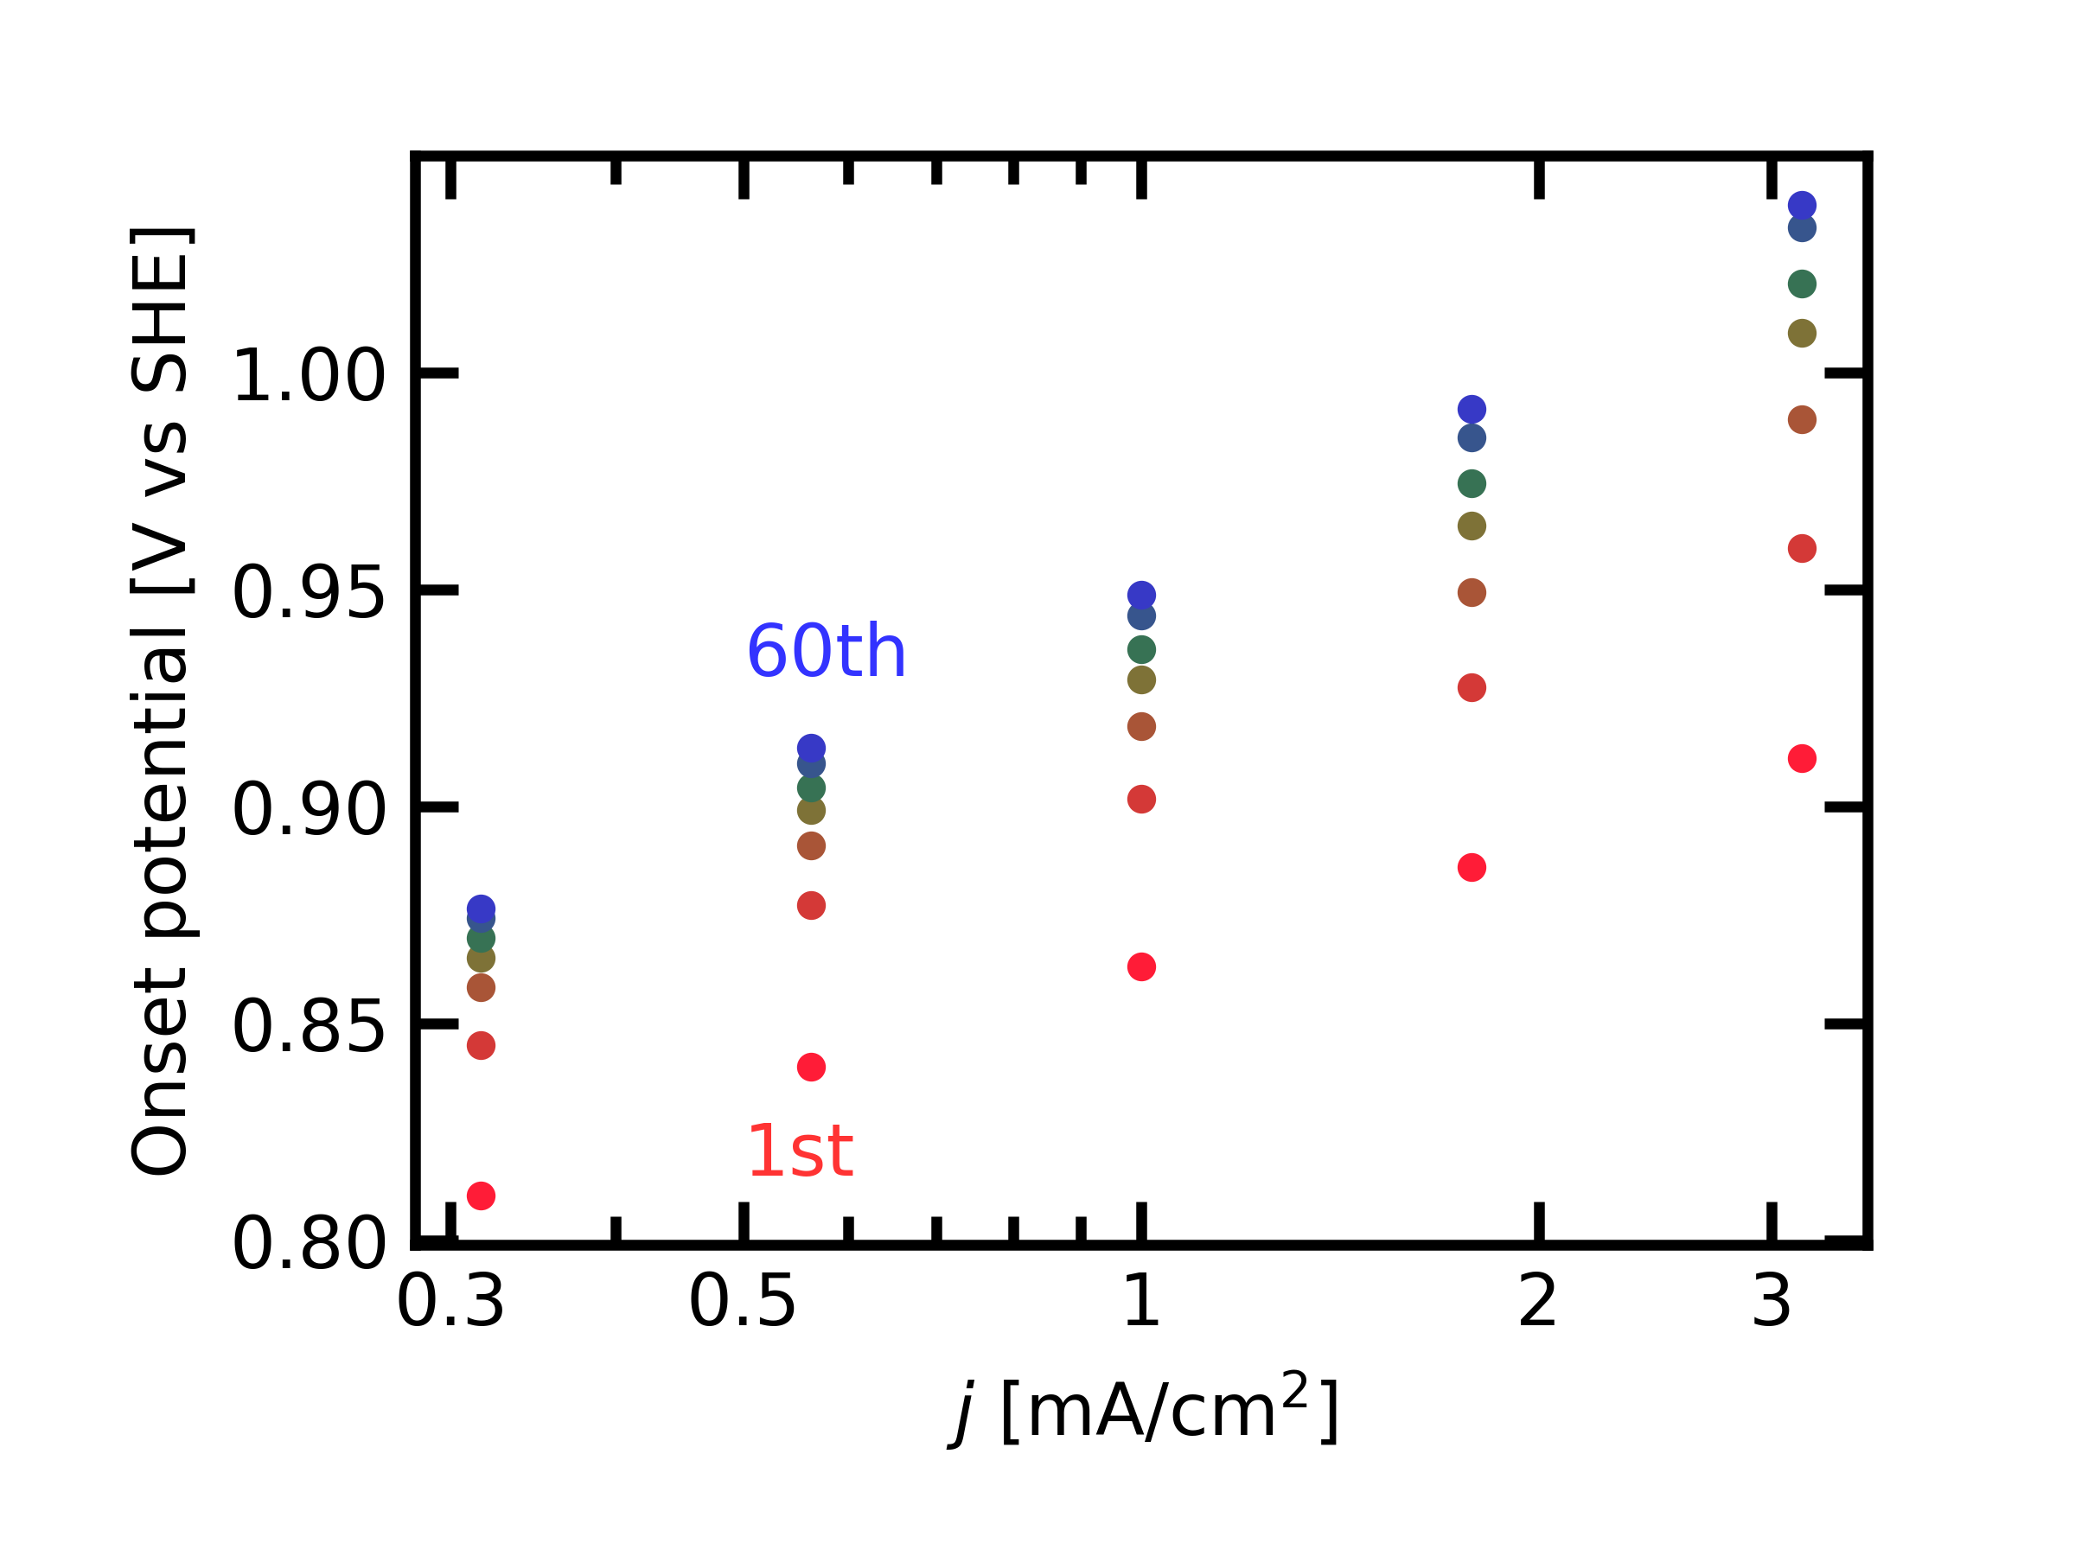
(A)
Mn 3p
72.0 % Mn^{III}
24.8% Mn^{IV}
3.2% Mn^{II}

Slide 4
No | Name | Position (eV) | FWHM (eV) | Line shape | At%
1 | Mn⁴⁺-Peak 1 | 49.58 | 1.55 | GL(20) | 17.50
2 | Mn⁴⁺-Peak 2 | 50.93 | 1.55 | GL(20) | 4.52
3 | Mn⁴⁺-Peak 3 | 52.32 | 1.55 | GL(20) | 1.66
4 | Mn⁴⁺-Peak 4 | 53.72 | 1.55 | GL(20) | 0.91
5 | Mn⁴⁺-Peak 5 | 55.2 | 1.55 | GL(20) | 0.18
6 | Mn³⁺-Peak 1 | 48.38 | 1.4 | GL(20) | 40.99
7 | Mn³⁺-Peak 2 | 49.56 | 1.4 | GL(20) | 17.46
8 | Mn³⁺-Peak 3 | 50.75 | 1.4 | GL(20) | 9.55
9 | Mn³⁺-Peak 4 | 52.16 | 1.4 | GL(20) | 3.98
10 | Mn³⁺-Peak 5 | 56.21 | 1.2 | GL(20) | 0.04
11 | Mn²⁺-Peak 1 | 47.18 | 1.4 | GL(20) | 2.22
12 | Mn²⁺-Peak 2 | 47.8 | 1.59 | GL(20) | 0.71
13 | Mn²⁺-Peak 3 | 49.23 | 3.41 | GL(20) | 0.28

